Slide 1
Day 01 Optimization Models and Single Objective Optimization

Slide 2
Learning goals
What is the subject area of multiobjective decision analysis and multiobjective optimization; How does it relate to the more general field of systems analysis and other disciplines?
What is a linear programming problem? How can we solve it graphically?
Geometrical meaning of active/non-active constraints.
What are the different types of optimization problems?
How can we formulate multiobjective optimization problems?
Why can their solution be difficult? What are the (current) limits?

Slide 3
Multicriteria Optimization and Decision Analysis
Definition: Multicriteria Decision Analysis (MCDA) assumes a finite number of alternatives and their multiple criteria value are known in the beginning of the solution process.
It provides methods to compare, evaluate, and rank solutions based on this information, and how to elicitate preferences.
Definition: Multicriteria Optimization (or: Multicriteria Design, Multicriteria Mathematical Programming) assumes that solutions are implicitly given by a large search space and objective and constraint functions that can be used to evaluate points in this search space.
It provides methods for (infinitly) search large spaces for interesting solutions or sets of solutions.

Slide 4
Systems Analysis View of Optimization

Slide 5
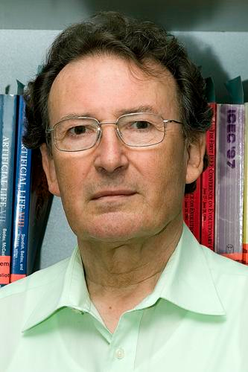
Optimization in Systems Analysis
Input
Systems Model
Output
!
?
!
Modelling,
(Identification,
Learning)
!
!
?
Simulation,
(Model-based Prediction,
Classification)
?
!
!
Optimization,
(Inverse Design,
Calibration)
Source: Hans-Paul Schwefel:
Technische Optimierung,
Lecture Notes, 1991
((c) picture: ersonal communication)

Slide 6
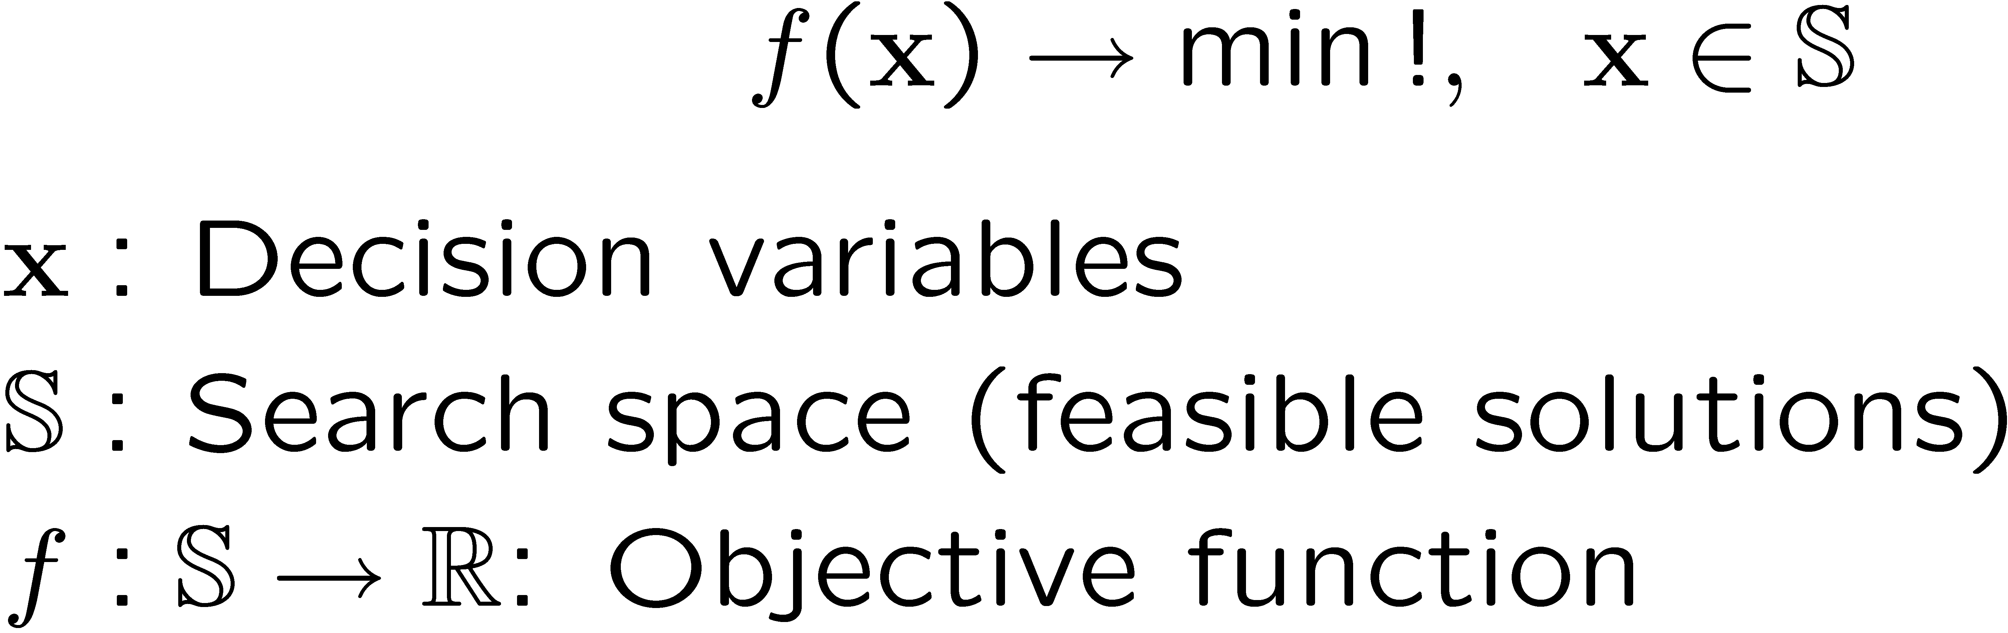
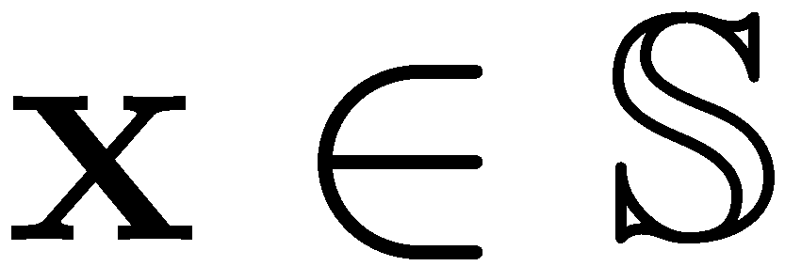
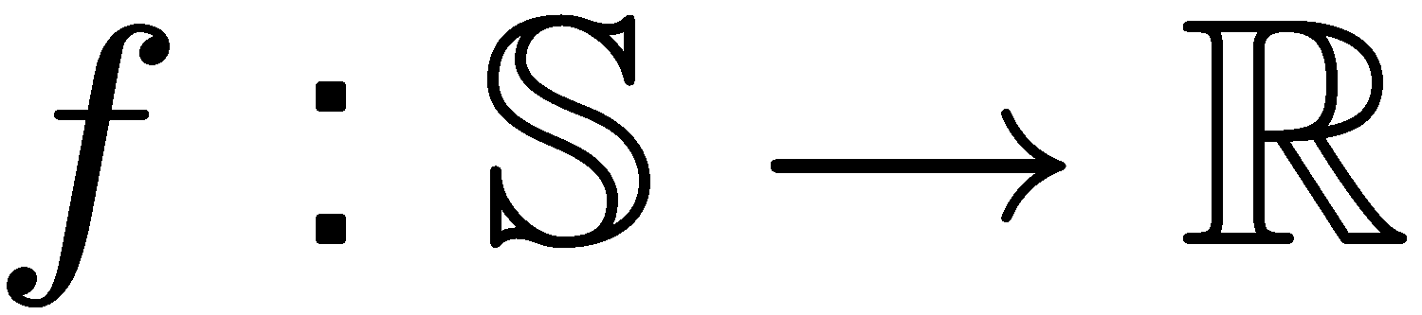

Systems Model of Optimization Task
?
!
!

Slide 7
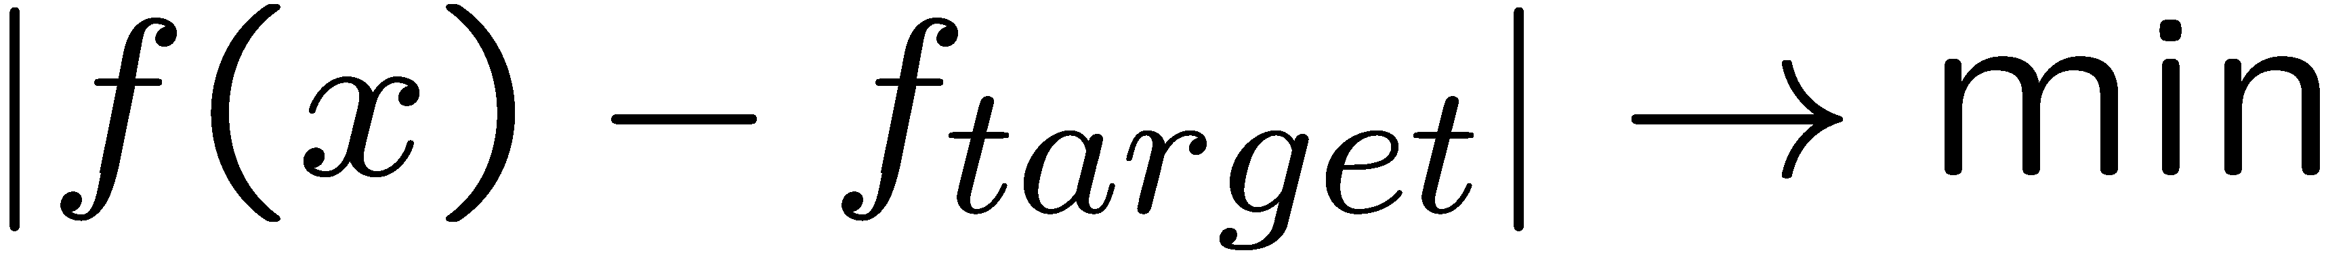
Constraints and restrictions
?
!
!

Slide 8
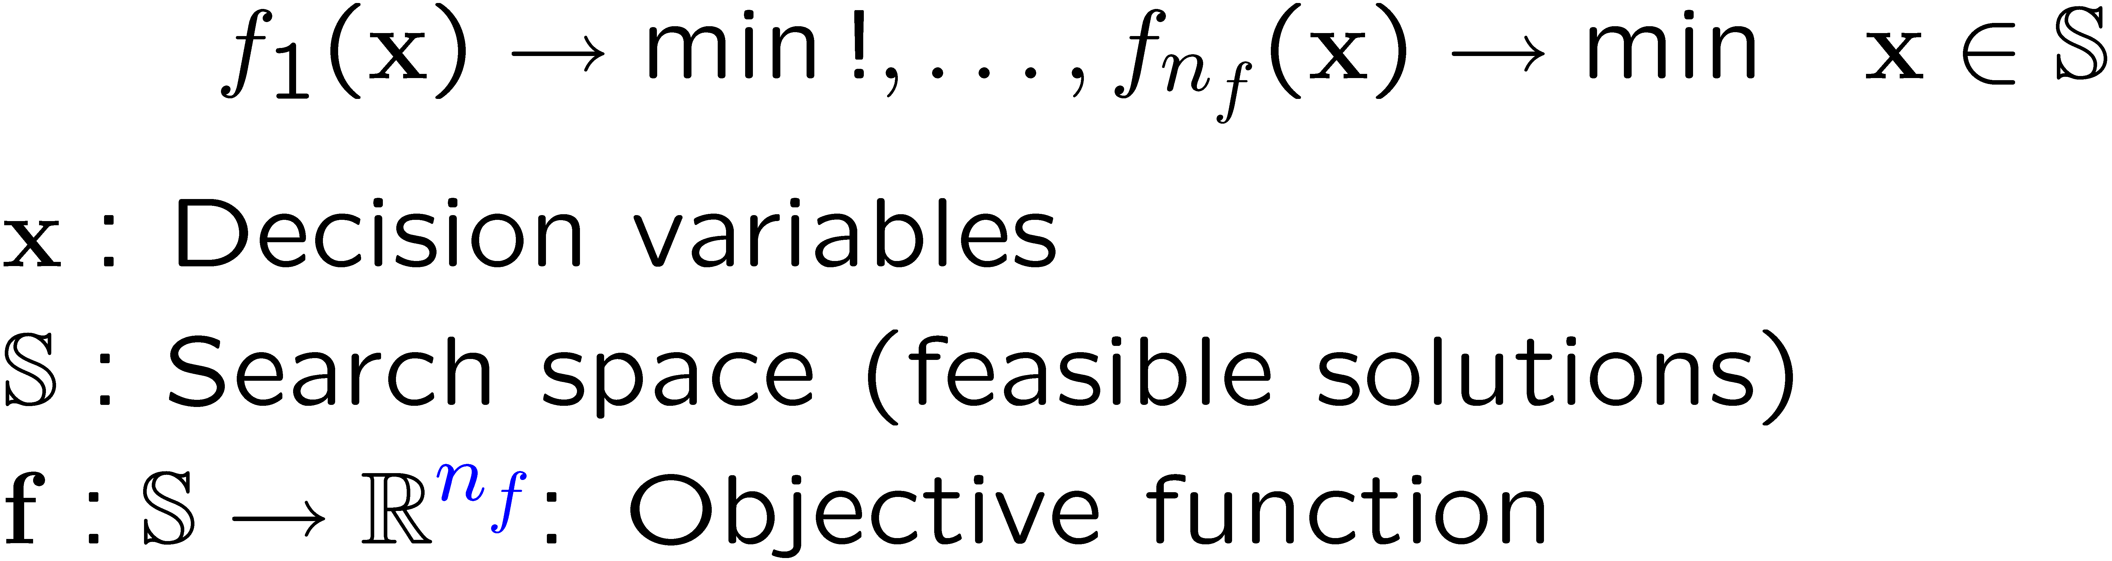

Multi-objective optimization task
?
!
!

Slide 9
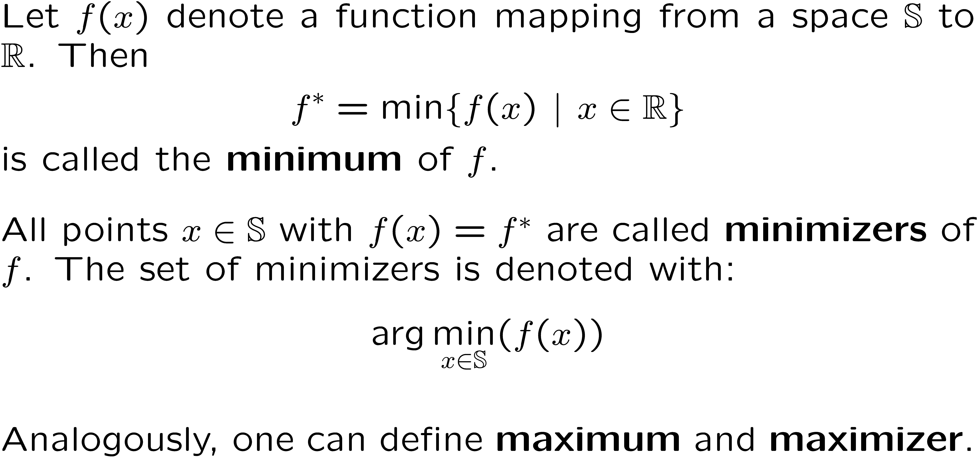
Def.: Minimum, minimizer

Slide 10
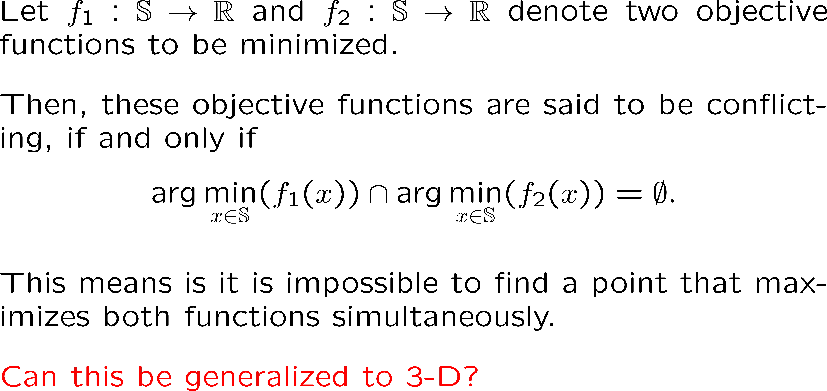
Def.: Conflicting objective functions

Slide 11
Standard formulation of mathematical programming

Slide 12
Linear programming

Slide 13
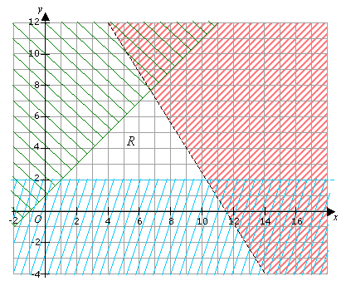
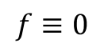
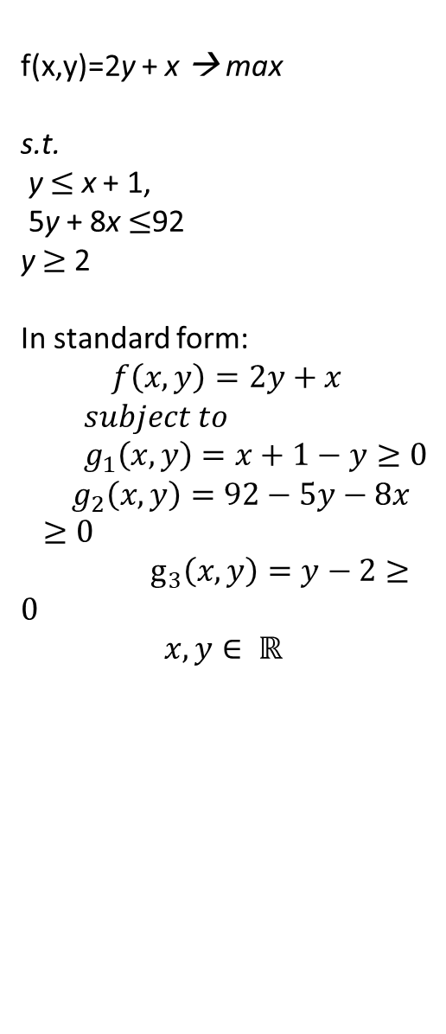
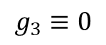
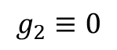
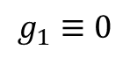
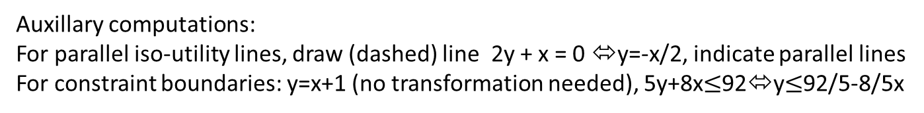
Linear programming: Graphical solution in 2D (http://www.onlinemathlearning.com/linear-programming-example.html)
f(x,y)=2y + x → max
s.t.
y $≤$ x + 1,
5y + 8x $≤$92
y $≥$ 2
In standard form:
$$f\left(x,y\right)=2y+x$$
$$subject to \\ { g}_{1}\left(x,y\right)=x+1−y≥0$$
$${ g}_{2}\left(x,y\right)=92−5y−8x≥0$$
$g_{3}\left(x,y\right)=y−2≥0$
$$x,y∈ ℝ$$
$$g_{2}≡0$$
$$g_{1}≡0$$
$$g_{3}≡0$$
$$f≡0$$
Auxillary computations:
For parallel iso-utility lines, draw (dashed) line 2y + x = 0 ⬄y=-x/2, indicate parallel lines
For constraint boundaries: y=x+1 (no transformation needed), 5y+8x$≤$92⬄y$≤$92/5-8/5x
Where is the maximizer? Which constraints are active?

Slide 14
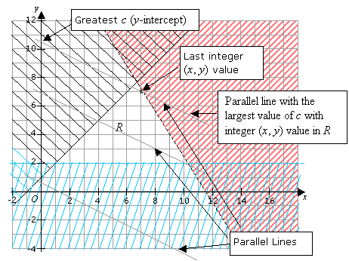
Linear integer programming
2y + x → max
s.t.
y = x + 1,
5y + 8x < 92
y > 2
x,y integer
For solvers of LP/MP problems: see for instance google OR tools:
https://developers.google.com/optimization/introduction/overview

Slide 15
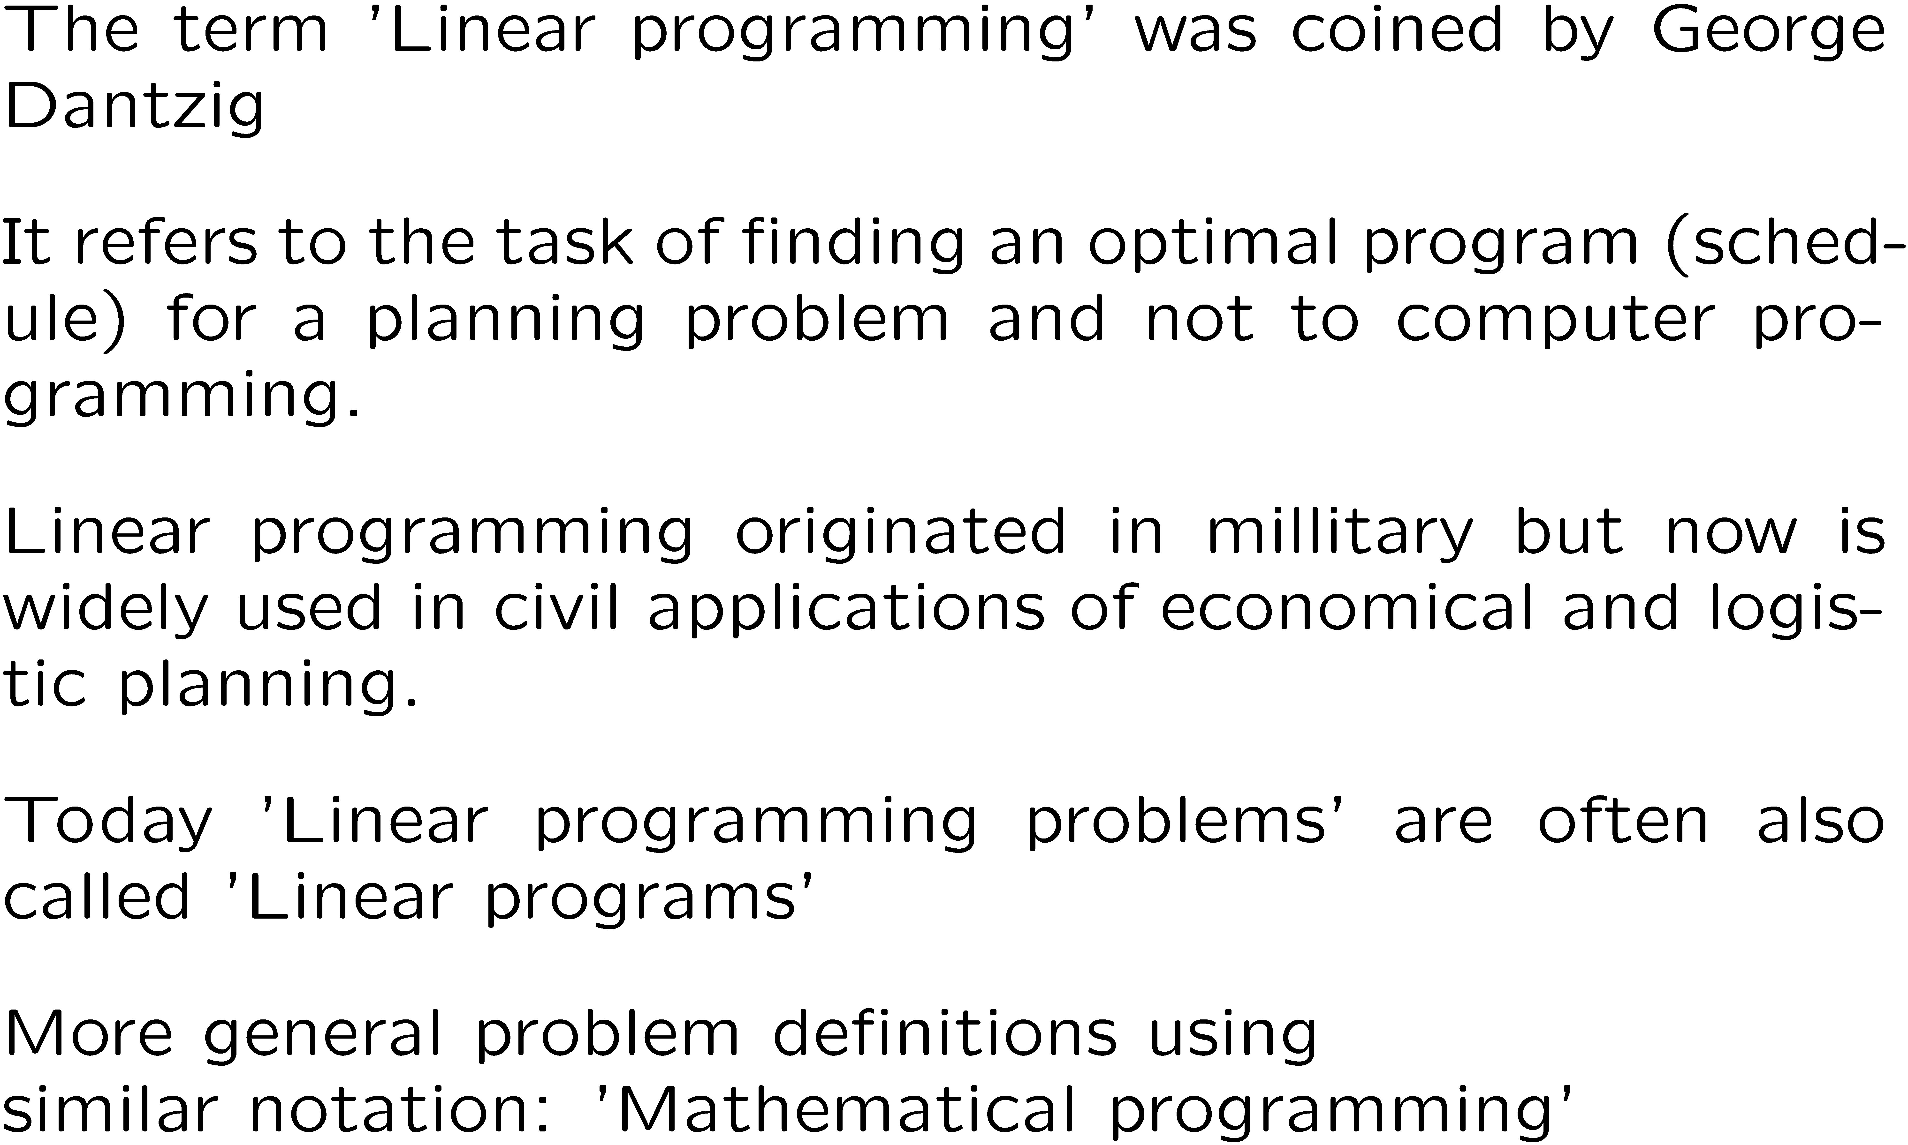
Mathematical ‘Programming’
*George Dantzig,
US American Mathematician, 1914 – 2005

Slide 16
Mathematical programs in standard form
multiobjective optimization

Slide 17
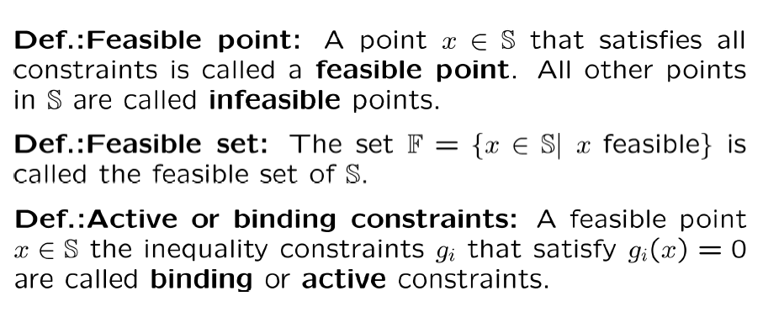
Terminology: Constraints

Slide 18






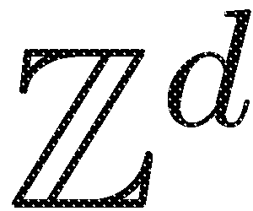


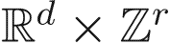
Classification: Mathematical Programming
*A QP is also an NLP; A ILP is also a IP.
For the comprehensive authorative classification of INFORMS by Dantzig, see: http://glossary.computing.society.informs.org/index.php?page=nature.html

Slide 19
Multiobjective Mathematical Program
multiobjective optimization

Slide 20

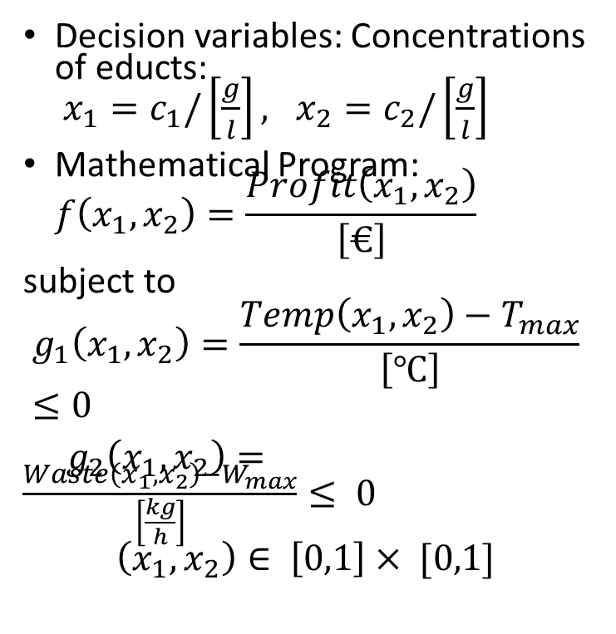
Example 1: Mathematical Program for Reactor
Chemical Reactor
Profit to be maximized, while temperature and waste must not exceed certain thresholds.
How to formulate this as a mathematical program?
Decision variables: Concentrations of educts: $x_{1}=c_{1}/\left[\frac{g}{l}\right], x_{2}=c_{2}/\left[\frac{g}{l}\right]$
Mathematical Program: $f\left(x_{1}, x_{2}\right)=\frac{Profit\left(x_{1},x_{2}\right)}{\left[€\right]}→Max$
subject to
$$g_{1}\left(x_{1},x_{2}\right)=\frac{Temp\left(x_{1},x_{2}\right)−T_{max}}{\left[℃\right]}≤0$$
$g_{2}\left(x_{1},x_{2}\right)=\frac{Waste\left(x_{1},x_{2}\right)−W_{max}}{\left[\frac{kg}{h}\right]}≤ 0$
$$\left(x_{1},x_{2}\right)∈ \left[0,1\right]× [0,1]$$
Profit(x1,x2)
Chemical
Reactor Model
x1
Waste(x1,x2)
Temperature(x1,x2)
x2

Slide 21

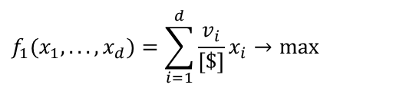
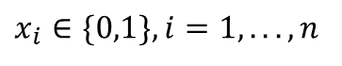
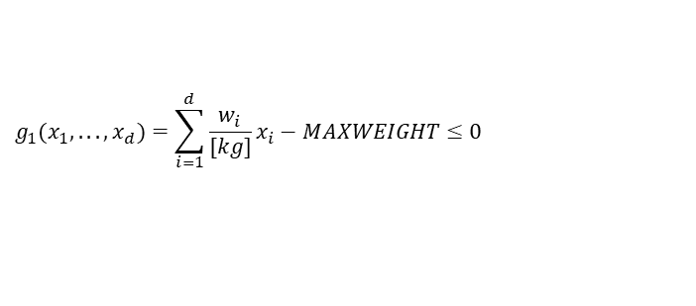
Example 2: Constrained 0/1 Knapsack Problem
The total value of the items in the knapsack (in [$]) should be maximized, while its total weight (in [kg]) should not exceed MAXWEIGHT. Here v_{i} is the value of item i in [$] and w_{i} is its weight in [kg]. i=1, …, d are indices of the items.
$$f_{1}(x_{1},...,x_{d})=\sum_{i=1}^{d}{\frac{v_{i}}{[\$]}}x_{i}→max$$
$$g_{1}(x_{1},...,x_{d})=\sum_{i=1}^{d}{\frac{w_{i}}{[kg]}x_{i}}−MAXWEIGHT≤0$$
$$x_{i}∈\{0,1\},i=1,...,n$$
Picture: © Michael Emmerich (instructor)
What is the role of the binary variables here?
What type of mathematical programming problem is this?
Can this also be formulated as a quadratic programming problem?

Slide 22
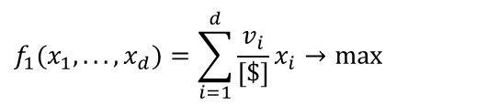
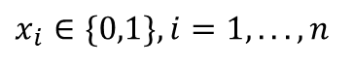
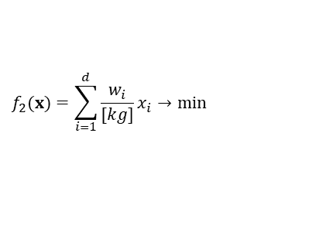
Example: Multiobjective 0/1 Knapsack Problem
The total value of the items in the knapsack (in [$]) should be maximized, while its total weight (in [kg]) should be minimized.
$$f_{1}(x_{1},...,x_{d})=\sum_{i=1}^{d}{\frac{v_{i}}{[\$]}}x_{i}→max$$
$$f_{2}(x)=\sum_{i=1}^{d}{\frac{w_{i}}{[kg]}x_{i}}→min$$
$$x_{i}∈\{0,1\},i=1,...,n$$

Slide 23
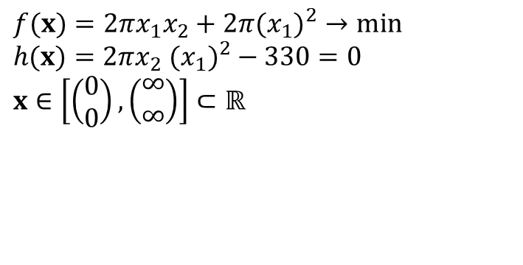
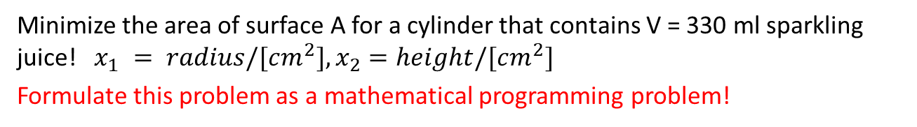
Example: Equality Constraint for Tin Problem
Minimize the area of surface A for a cylinder that contains V = 330 ml sparkling juice! $x_{1} = radius/[cm^{2}], x_{2}=height/[cm^{2}]$
Formulate this problem as a mathematical programming problem!
x₁
$$f(x)=2πx_{1}x_{2}+2π(x_{1})^{2}→min \\ h(x)=2πx_{2} (x_{1})^{2}−330=0 \\ x∈\left[\left(\begin{matrix}0 \\ 0\end{matrix}\right),\left(\begin{matrix}∞ \\ ∞\end{matrix}\right)\right]⊂ℝ$$
330ml
x₂
Problem sketch
Some interesting research question: Find optimal shapes or given constraints on geometry.
For instance: Convex hull of N points with minimal surface and maximal volume.

Slide 24
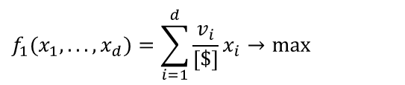
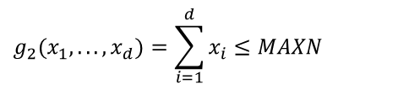
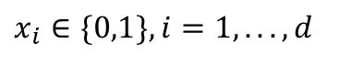
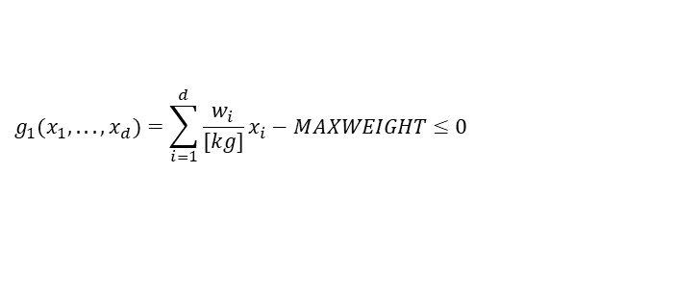
Example: Knapsack Problem with Cardinality Constraint
The total value of the items in the knapsack (in [$]) should be maximized, while its total weight (in [kg]) should be below MAXN and at most MAXN items can be chosen.
$$f_{1}(x_{1},...,x_{d})=\sum_{i=1}^{d}{\frac{v_{i}}{[\$]}}x_{i}→max$$
$$g_{1}(x_{1},...,x_{d})=\sum_{i=1}^{d}{\frac{w_{i}}{[kg]}x_{i}}−MAXWEIGHT≤0$$
$$g_{2}(x_{1},...,x_{d})=\sum_{i=1}^{d}{x_{i}}≤MAXN$$
$$x_{i}∈\{0,1\},i=1,...,d$$

Slide 25
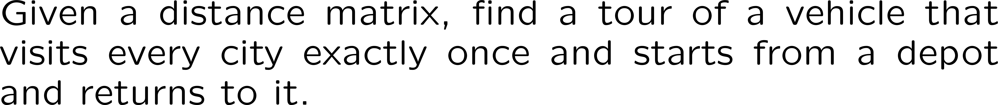
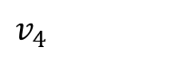








Example: Traveling Salesperson Problem
$v_{o}$
$v_{1}$
$v_{8}$
$v_{7}$
$v_{5}$
$v_{6}$
$v_{4}$
$v_{2}$
$v_{3}$
This can be easily described, but how to model this in terms of discrete (binary) variables and (constraint) functions that depend on them?

Slide 26
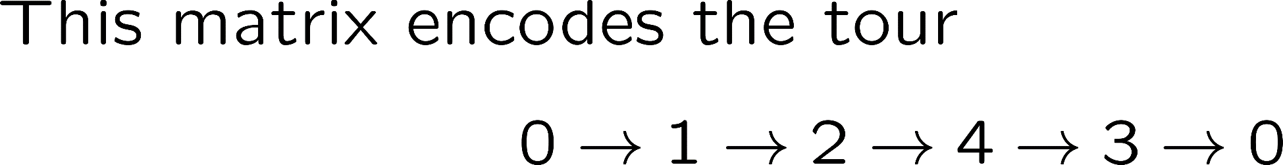
Encoding of a TSP tour
City 1 | City 2 | City 3 | City 4
1 | 0 | 0 | 0
0 | 1 | 0 | 0
0 | 0 | 0 | 1
0 | 0 | 1 | 0

Slide 27
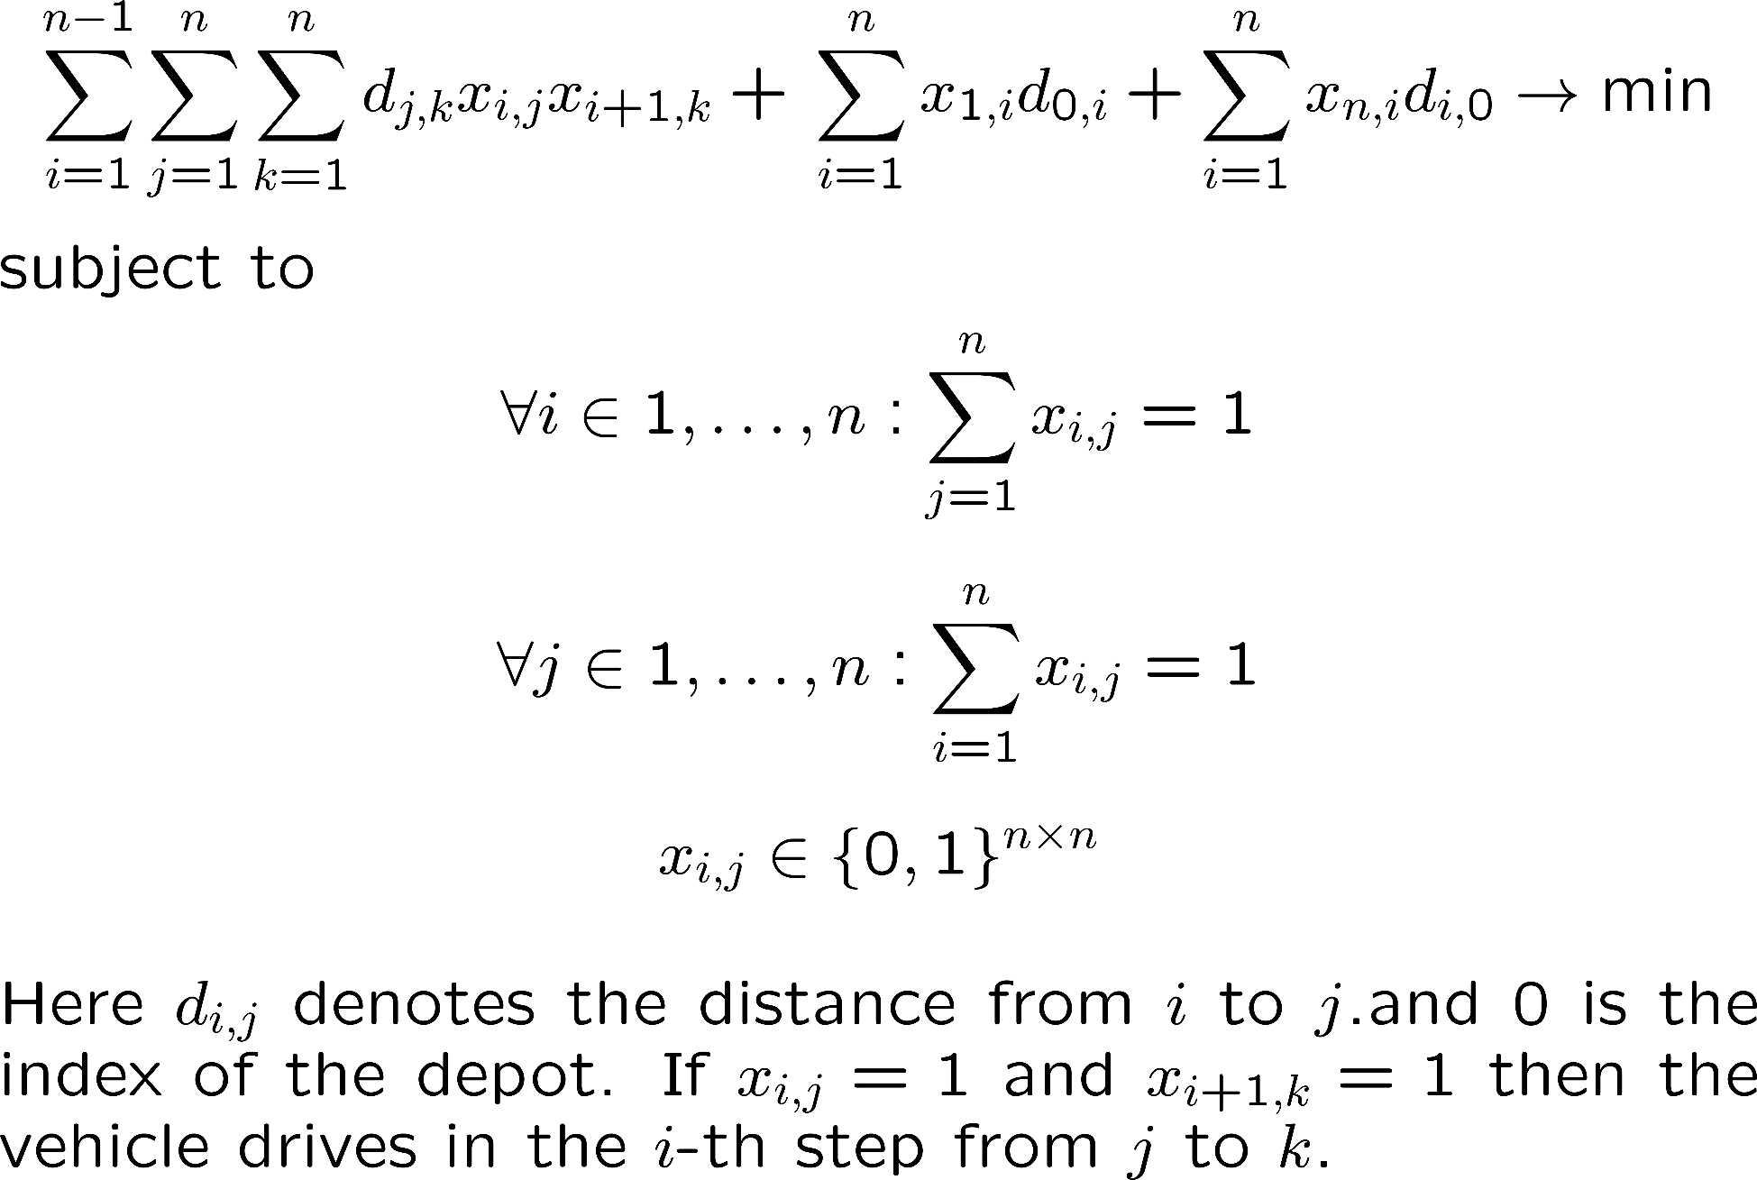
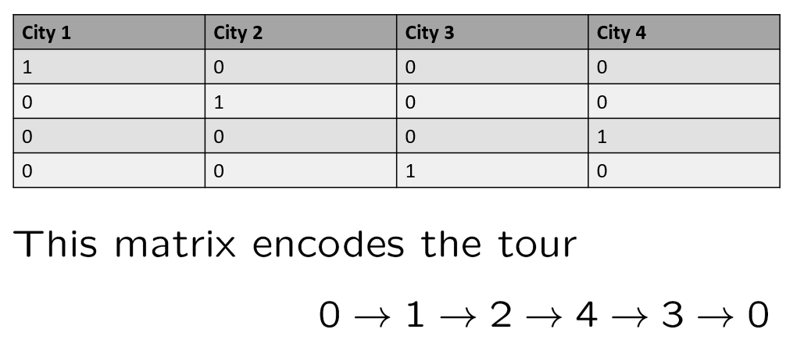

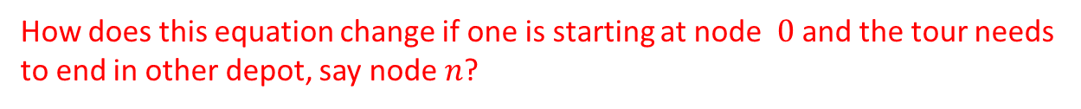
Recall. Previous slide
How does this equation change if one is starting at node $0$ and the tour needs to end in other depot, say node $n$?

Slide 28
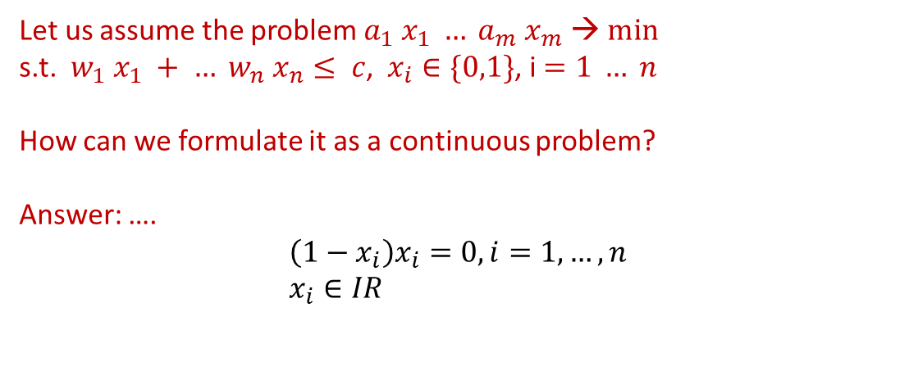
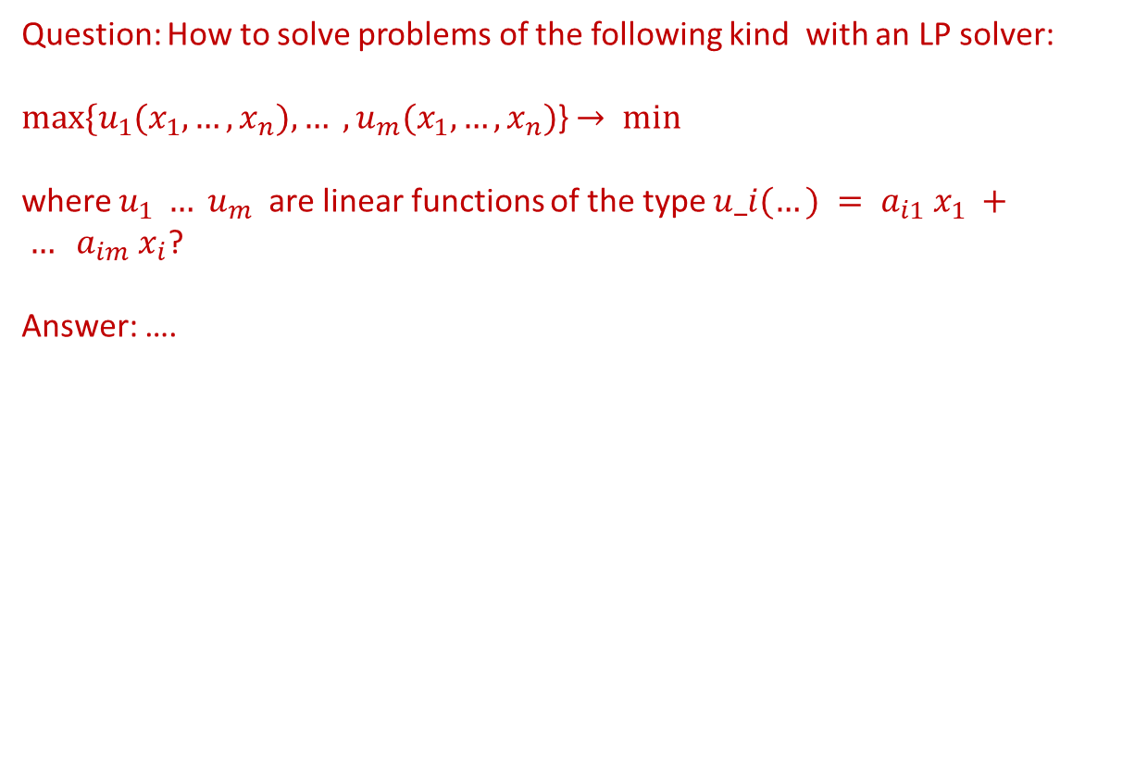

Mathematical Programming Models
Question: How to solve problems of the following kind with an LP solver:
$max⁡\{u_{1}(x_{1}, …, x_{n}), … ,u_{m}(x_{1}, …, x_{n})$} $→ min$
where $u_{1} … u_{m}$ are linear functions of the type $u_i(…) = a_{i1} x_{1} + … a_{im} x_{i}$?
Answer: ….
$$f\left(x_{1},…, x_{n},x_{n+1}\right)=x_{n+1}→min$$
$$s.t. a_{i1}x_{1}+…a_{im}x_{i}≤x_{n+1} , i=1,…,m$$
Let us assume the problem $a_{1} x_{1} … a_{m} x_{m} → min⁡$
s.t. $w_{1} x_{1} + … w_{n} x_{n}≤ c$, $x_{i}∈\{0,1\}$, i$=1 … n$
How can we formulate it as a continuous problem?
Answer: ….
$$\left(1−x_{i}\right)x_{i}=0, i=1,…,n \\ x_{i}∈IR$$

Slide 29
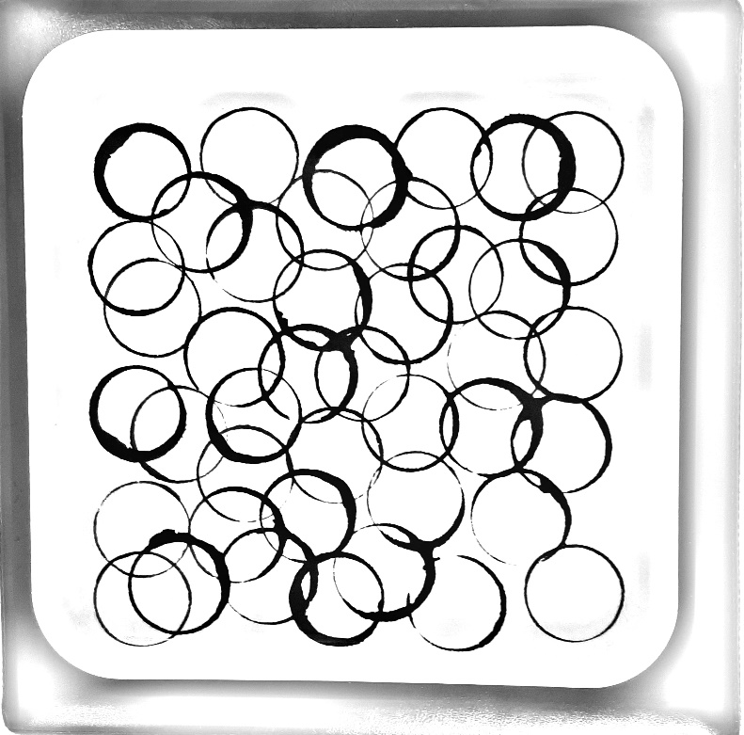
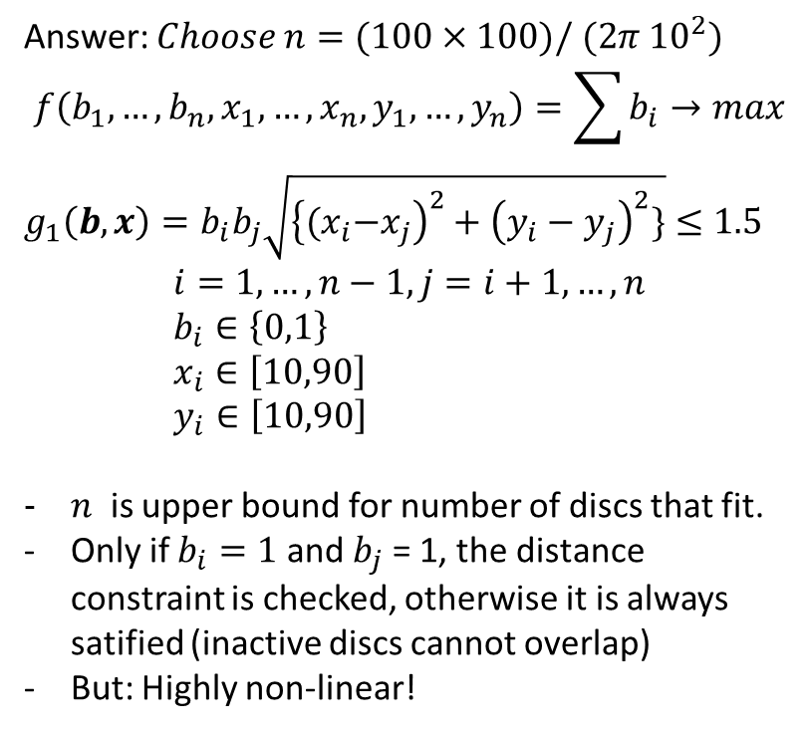
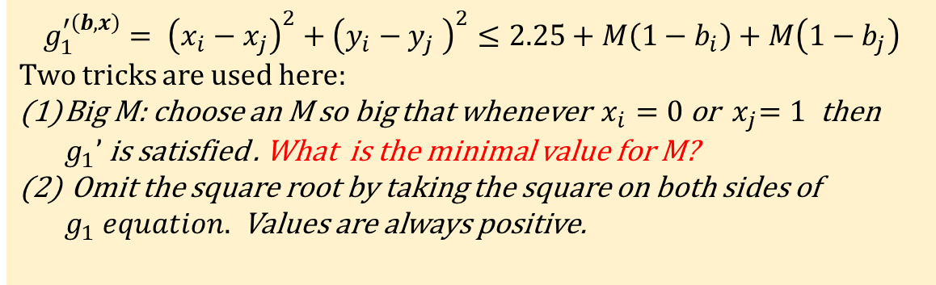
Placement of unit discs on the square – mixed integer problem – ‘Big M trick’
How to formulate the problem of placing as many unit discs of radius 1.5m possible on a square of side length 100meter? The unit discs may not overlap.
Answer: $Choose n=(100×100)/ (2π {10}^{2})$
$$f\left({b_{1},…, b_{n},x}_{1},…, x_{n},y_{1},…,y_{n}\right)=\sum{b_{i}}→max$$ ${g_{1}\left(b,x\right)=b}_{i}b_{j}\sqrt{{\left\{{(x}_{i}−x_{j}\right)}^{2}+{\left(y_{i}−y_{j}\right)}^{2}\}}≤1.5$ $$i=1,…,n−1,j=i+1,…, n \\ b_{i}∈\left\{0,1\right\} \\ x_{i}∈\left[10,90\right] \\ y_{i}∈\left[10,90\right]$$
$n$ is upper bound for number of discs that fit.
Only if $b_{i}=1$ and $b_{j}$ = 1, the distance constraint is checked, otherwise it is always satified (inactive discs cannot overlap)
But: Highly non-linear!
Unit disc problem: Infeasible design due to overlap.
Alternative QP formulation (big M trick):
$$g_{1}^{′\left(b,x\right)}= {\left(x_{i}−x_{j}\right)}^{2}+{\left(y_{i}−y_{j} \right)}^{2}≤2.25+M\left(1−b_{i}\right)+M\left(1−b_{j}\right)$$ Two tricks are used here:
Big M: choose an M so big that whenever $x_{i}=0$ or ${ x}_{j}=1$ then $g_{1}’$ is satisfied . What is the minimal value for M?
Omit the square root by taking the square on both sides of $g_{1} equation.$ Values are always positive.

Slide 30
Complexity of optimization problems

Slide 31
Continuous optimization
Complexity of optimization problems

Slide 32
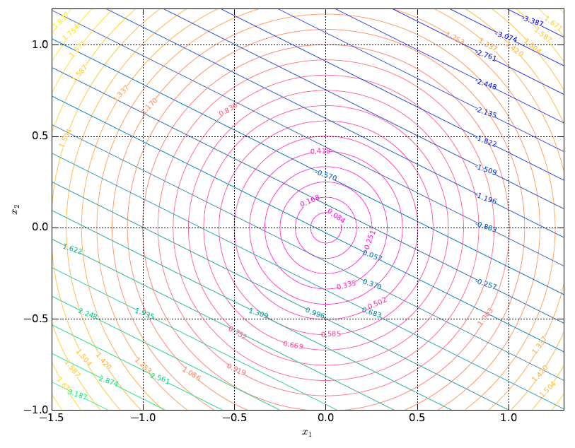
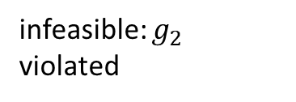
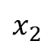

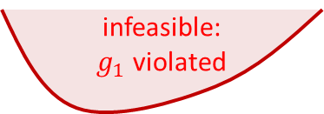

Difficulties in Nonlinear Programming and Continuous Unconstrained Optimization
Non-robust maximizer (one easily drops off)
Multimodal functions (many local optima)
Plateaus and discontinuities
Non-differentiability
Nonlinear active boundaries of restriction functions
Disconnected feasible subspaces.
High dimensionality
Noise/Robustness
f(x)
local minimum
plateau
discontinuity
x
noise
infeasible:
$g_{1}$ violated
$$x^{∗}$$
$$x_{2}$$
infeasible: $g_{2}$ violated
$$x_{1}$$

Slide 33
Simulated Annealing and Stochastic Hillclimbing Methods
We start with an intial

Slide 34
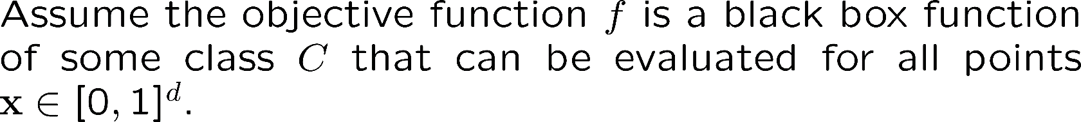
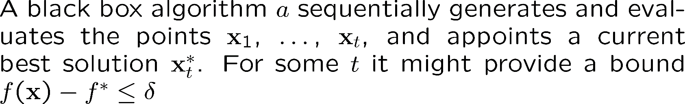


Black-box Optimization & Information Based Complexity

Slide 35


Fundamental bounds in continuous optimization

Slide 36

Fundamental bounds in continuous optimization

Slide 37


Lipschitz continuity uncertainty margins (1-D python code)
https://trinket.io/python3/c38e5ebdbc
We have evaluated 4 points,
and Lipschitz constant is 4.0
© by Michael Emmerich (MODA instructor), all rights reserved

Slide 38






Curse of dimensionality (proof)

Slide 39
Combinatorial optimization
Complexity of optimization problems

Slide 40

Decision version of optimization problem

Slide 41



NP hard problems
(c) https://ac.tuwien.ac.at/people/szeider/cartoon/… cf. @vardi
How we lost the women in computing (based on Garey and Johnson's classic 1979) https://cacm.acm.org/magazines/2018/5/227192-how-we-lost-the-women-in-computing/fulltext… #womenintech #STEM #computerscience

Slide 42

NP hard problems

Slide 43

NP, NP-Complete, NP-Hard
2007-11-01 21:30 Behnam 1052×744×0 (9751 bytes) Venn diagram for P, NP, NP-Complete, and NP-Hard problems, creative commons licence, https://creativecommons.org/licenses/by-sa/3.0/deed.en

Slide 44

Difficulties in solving mathematical programming problems
Karmarkar, N. (1984, December). A new polynomial-time algorithm for linear programming. In Proceedings of the sixteenth annual ACM symposium on Theory of computing (pp. 302-311). ACM.
Monteiro, R. D., & Adler, I. (1989). Interior path following primal-dual algorithms. Part II: Convex quadratic programming. Mathematical Programming, 44(1-3), 43-66.
Androulakis, Ioannis P., Costas D. Maranas, and Christodoulos A. Floudas. "αBB: A global optimization method for general constrained nonconvex problems." Journal of Global Optimization 7.4 (1995): 337-363.

Slide 45

https://xkcd.com/287/
This work is licensed under a Creative Commons Attribution-NonCommercial 2.5 License.

Slide 46





Search heuristics, Branch and Bound
Branch&Bound:
“It’s certainly not found in this part”
Search space and problem:
“What is the biggest fish in a
very large lake”
Heuristic:
“I used some tricks to catch a big fish, but don’t know if
there is a bigger one?” (https://pixabay.com/illustrations/fishing-fisherman-big-fish-boar-4712416/)
(c) (left, right picture) Michael Emmerich (instructor)

Slide 47

Summary: Take home messages (1)
Modeling, simulation, and optimization are essential tools in systems analysis; A simple black box scheme can be used to capture their definition.
In operations research, optimization problems are classified in the form of mathemathical programming problems
The most simple mathematical programming task is linear programming
The classification scheme refers to the type of variables (e.g. binary, integer) and functions (e.g., quadratic, linear, nonlinear)
Standard solvers are available to solve mathematical programming problems; but problems might be difficult;

Slide 48
Summary: Take home messages (2)
Difficulties in continuous optimization arise due to local optima, plateaus, discontinuities and constraint boundaries.
In black box optimization: curse of dimensionality makes it difficult to guarantee optimal solution, even for Lipschitz continuous functions
In combinatorial optimization decision versions of many multiobjective optimization problems are NP-hard
Heuristics can find improvements, but often do not guarantee to find the optimum

